Slide 1
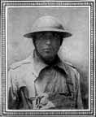
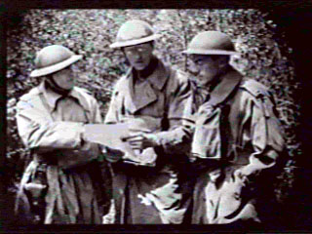
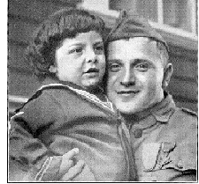
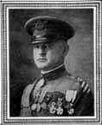
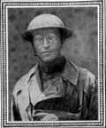
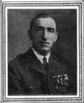
Captain McMurtry, Major Whittlesey and Lt. Cullen in 1919
Corporal Irving Klein
Captain George G. McMurtry
Captain Nelson M. Holderman
Major Charles W. Whittlesey
Private Abraham Krotoshinsky
Notes:
http://prosites-johnrcotter.homestead.com/lost_battalion_heroes.html

